Slide 1
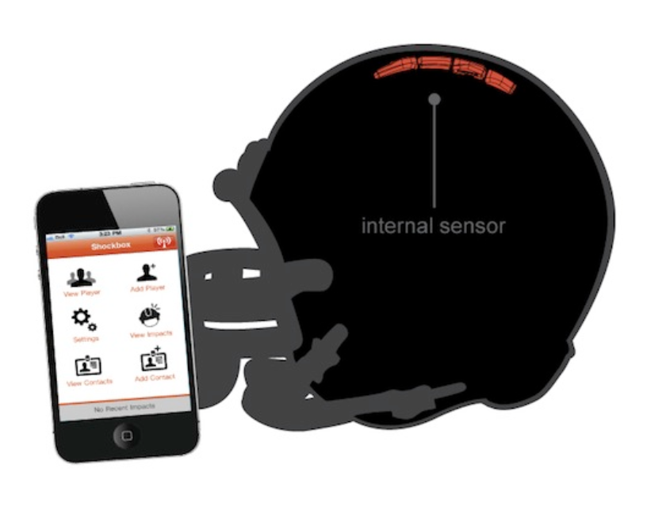
Helmet Integrated Impact
Detection System
(HI-IDS)
Presenter: Socheath Sok
Role: Software Design

Slide 2
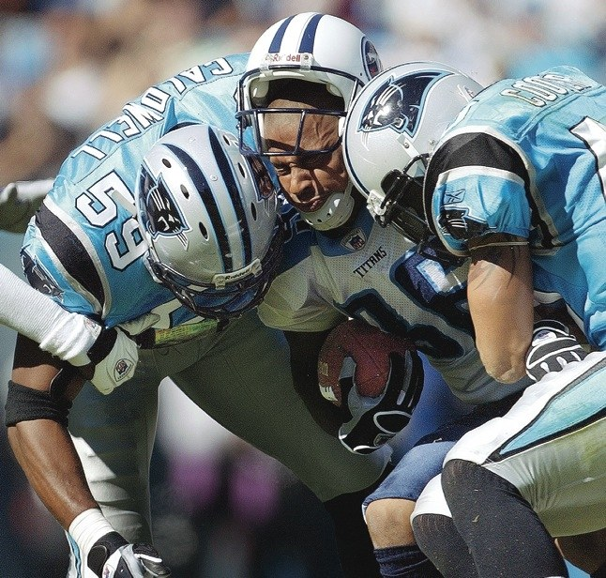
Figure 1. NFL players making helmet on helmet contact

Slide 3
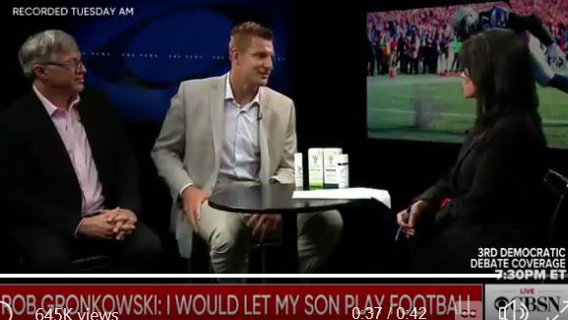
Current Event
Figure 2. NFL player, Rob Gronkowski, admits he has suffered 20 concussions and 5 blackout moments.
Notes:
Sept.12,2019… New England Patriots, 5 blackouts

Slide 4
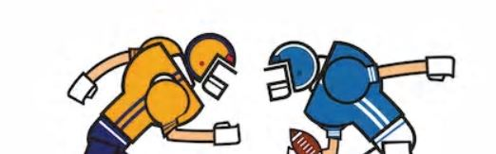
Helmet Integrated Impact Detection System (HI-IDS)
Detect unreported concussions
Allow coaches and physicians to monitor head impacts
receive alerts when a player is in danger of a concussion
Notes:
While at the same time … is durable and comfortable enough to be used like any regular football helmet
The software connect to the helmet will enable … to monitor…. And send alerts ..

Slide 5

Overview
Team
Technical Objectives
Desired Functionalities
Use Cases
Realistic Constraints
Standards Usage
Preliminary Parts Lists
Summary

Slide 6


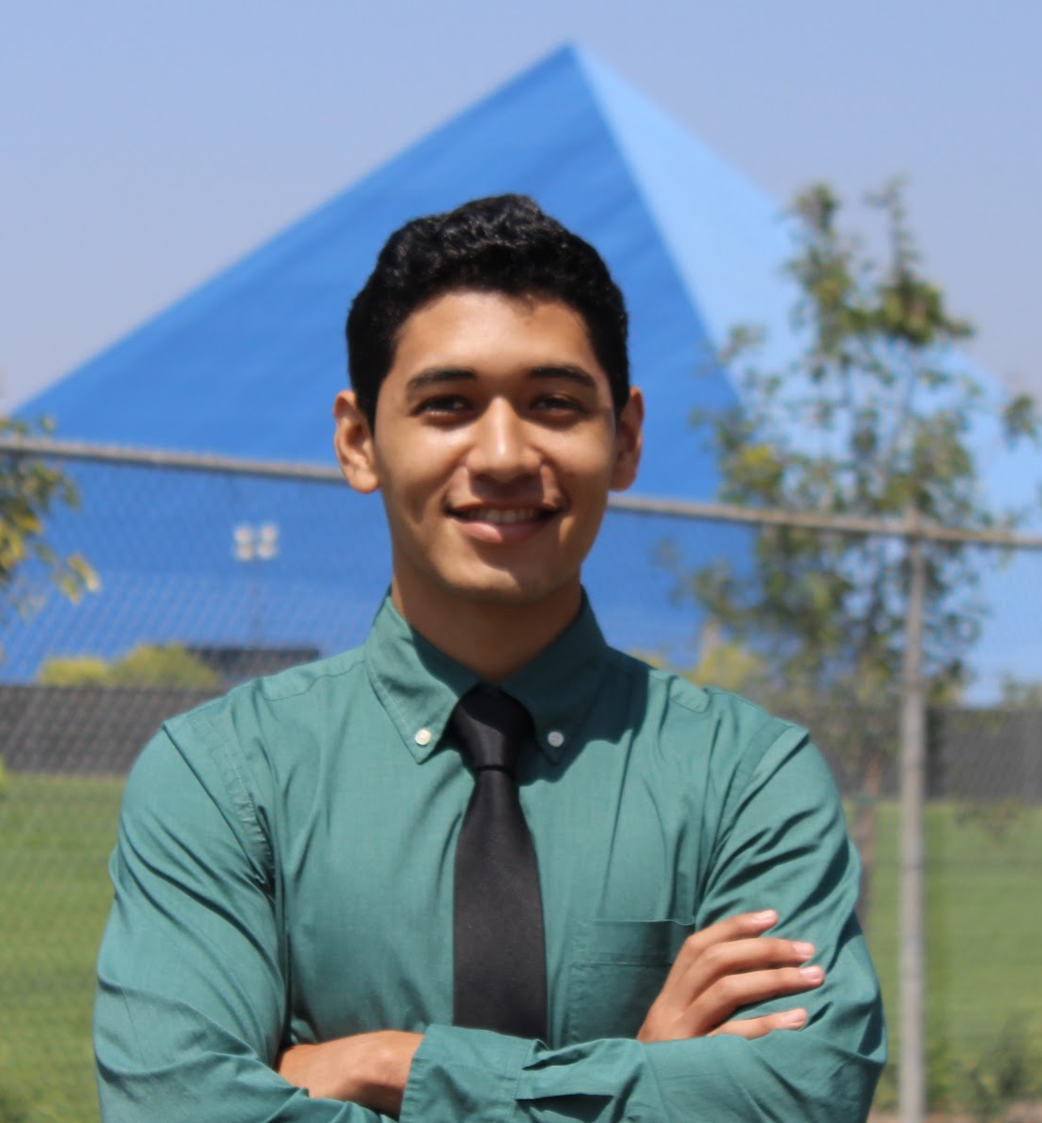

Team
Jasmine Arrieta
Role: Hardware Design
Emphasis: Electronics
Experience: 3D Printing, Creo, Python, Power Systems
Calvin Lee
Role: Software testing &
development
Emphasis: Communications
Experience: C++ / Python
Rhyan Gonzalez
Role: Hardware Design
Emphasis: Electronics
Experience: C++, VHDL, Matlab
Socheath Sok
Role: Software Design
Emphasis: BME
Experience: MATLAB, Simulink, VHDL, & Assembly

Slide 7
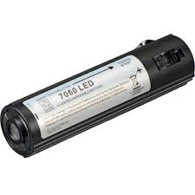
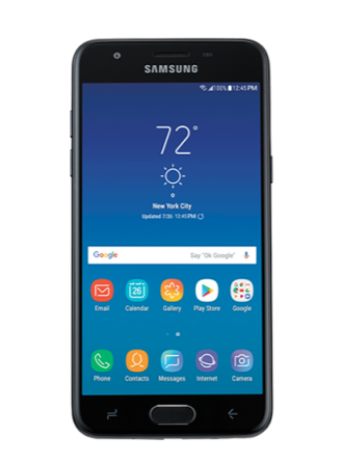
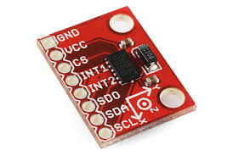

Technical Objectives
Seamlessly integrate the sensor into the helmet
Measure impacts between +/- 200 G force
Communication range of at least 50 meters
Powered by rechargeable batteries

Slide 8

Desired Functionalities
Measure collisions to the helmet
Transmit the data collected from the helmet wirelessly to an app
Send an alert on the app when a helmet collision exceeds a certain threshold
Display a history of impact data over a selected period of time

Slide 9
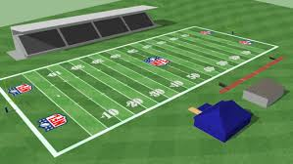
Use Cases
Suitable for
Football players of any level
Real games and practices
Software application is controlled by
Coaches
Physicians

Slide 10

Realistic Constraints
Social and Ethical
App will be available on IOS and Android
User interface must be simple and easy to navigate
The final product must perform all of the desired functionalities
Manufacturability
System must be properly connected before integrating into the helmet.
Must not affect the player’s performance

Slide 11
Realistic Constraints
cont.
Economic
Manufacturing cost must be less than $200
App can be connected to multiple devices
Data must be able to transfer from the sensor to the app wirelessly
Environmental, Political, Health, and Safety
Lithium ion battery must be recycled as hazardous waste
System must not overheat
This type of smart helmet has been done before

Slide 12
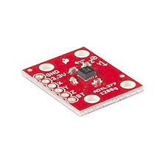
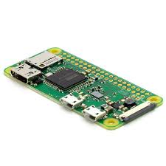
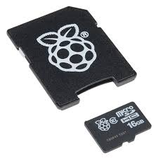
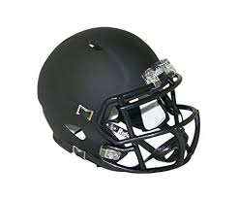
Parts List
Accelerometer Raspberry Pi Zero W 16 GB Rechargeable
(ADXL3770) Micro SD card Lithium Ion Battery
Football Helmet

Slide 13
Standards Usage
IEC 60086-4 Ed. 4.0 b:2014
Primary batteries - Part 4: Safety of lithium batteries
IEEE 802.11b-1999
IEEE Standard for Information Technology - Telecommunications and information exchange between systems - Local and Metropolitan networks - Specific requirements - Part 11: Wireless LAN Medium Access Control (MAC) and Physical Layer (PHY) specifications: Higher Speed Physical Layer (PHY) Extension in the 2.4 GHz band
IEEE 836-2001
IEEE Recommended Practice for Precision Centrifuge Testing of Linear Accelerometers
ISO/IEC 9126-1:2001
Software engineering — Product quality — Part 1: Quality model
UHS-III
UHS-III SD Memory Card Standard
Notes:
International Electrotechnical Commission, Institute of Electrical and Electronics Engineers, Ultra High Speed

Slide 14
Summary
Figure 1. NFL players making helmet on helmet contact

Slide 15
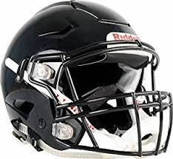

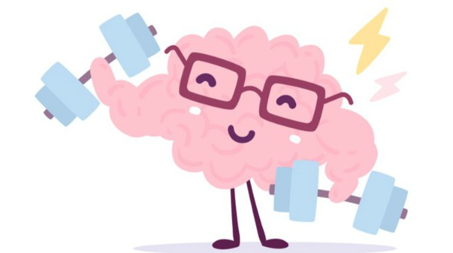
HI-IDS to designed to help football players by allowing coaches and physicians to detect head impacts in order to diagnose possible concussions

Slide 16
References
Marklesparklesports. “Are the NFL Rules Getting Too Soft?” Markle Sparkle
Sports, Figure 1, 21 Aug. 2018, https://marklesparklesports.com/2018/08/20/are-the-nfl-rules-getting-too-soft/
CBS News. “Rob Gronkowski Says He Probably Had 20 Concussions and 5
Blackouts in His Career.” CBS News, CBS Interactive, 13 Sept. 2019, https://www.cbsnews.com/news/gronk-concussions-rob-gronkowski-former-new-england-patriots-tight-end-discusses-football-career-2019-09-12/.

Slide 17

Questions?

Slide 18
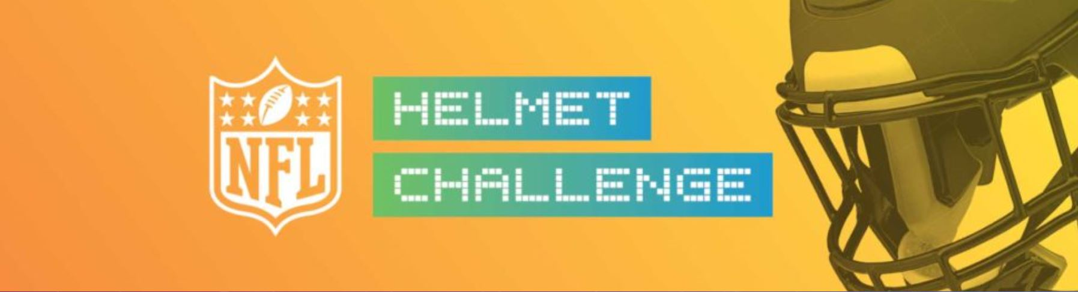
Current Event Con’t
Figure 1.1 The NFL launched a $3Million innovation challenge

Slide 19
References
https://twitter.com/CBSNews/status/1172207959251783682?ref_src=twsrc%5Etfw%7Ctwcamp%5Etweetembed%7Ctwterm%5E1172207959251783682&ref_url=https%3A%2F%2Fwww.cbssports.com%2Fnfl%2Fnews%2Frob-gronkowski-admits-to-having-nearly-20-concussions-blacking-out-five-times-in-his-nfl-career-with-patriots%2F
https://www.playsmartplaysafe.com/nfl-helmet-challenge/

